Slide 1
CPSC 375 Introduction to Data Science and Big Data Analytics
Dr. Anand Panangadan
apanangadan@fullerton.edu

Slide 2
What we will cover this week
Evaluation metrics

Slide 3
Why evaluation?
Quantitatively compare different classifiers for a given dataset
Which one is better?

Slide 4
Supervised Learning
Features
Labels
Petal Length | Petal Width | Sepal Length | Sepal Width | Species
5.1 | 3.5 | 1.4 | 0.2 | Setosa
4.9 | 3.0 | 1.4 | 0.2 | Setosa
6.2 | 2.9 | 4.3 | 1.3 | Versicolor
6.3 | 3.3 | 6.0 | 2.5 | Virginica
5.1 | 2.5 | 3.0 | 1.1 | Versicolor
7.1 | 3.0 | 5.9 | 2.1 | Virginica
Training data
5.1 | 3.5 | 1.4 | 0.2 | Setosa | ?
7.1 | 3.0 | 5.9 | 2.1 | Virginica | ?
Test data
Ground
truth
Predictions

Slide 5
Classifier Evaluation Metrics: Confusion Matrix
Compare ground truth with predictions
If they match it is called “True”
If not, it is “False”
A prediction can take one of two values
called Positive or Negative
Also called “Contingency Table”
In R: table(x, y)
 | Predicted class
Actual class | C₁(Positives) | ¬ C₁(Negatives)
C₁(Positives) | True Positives (TP) | False Negatives (FN)
¬ C₁(Negatives) | False Positives (FP) | True Negatives (TN)
5

Slide 6
Accuracy and Error Rate
A\P | C | ¬C
C | TP | FN | P
¬C | FP | TN | N
 |  |  | All
Accuracy: percentage of test set data that are correctly classified
Accuracy = (TP + TN)/All
Error rate: 1 – accuracy, or
Error rate = (FP + FN)/All
Note: P = TP + FN
N = FP + TN
All = P +N = TP + FN + FP + TN
6

Slide 7
Be careful of “Accuracy”
Class Imbalance Problem:
One class may be rare, e.g. fraud, or HIV-positive
Accuracy is dominated by the larger set (of positives or negatives) and favors trivial classifiers.
e.g. if 5% of items are truly positive, then a classifier that always says “negative” is 95% accurate.

Slide 8
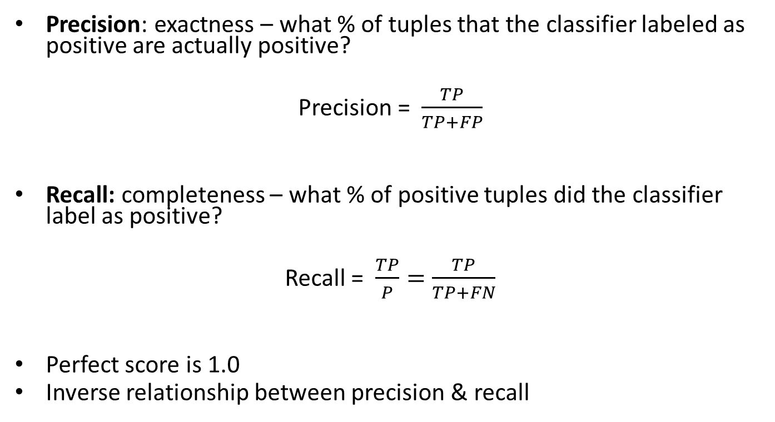
Precision and Recall
Precision: exactness – what % of tuples that the classifier labeled as positive are actually positive?
Precision = $\frac{TP}{TP+FP}$
Recall: completeness – what % of positive tuples did the classifier label as positive?
Recall = $\frac{TP}{P}=\frac{TP}{TP+FN}$
Perfect score is 1.0
Inverse relationship between precision & recall
8

Slide 9

F-measures
F measure (F₁ or F-score):
harmonic mean of precision and recall
F = $\frac{2×precision×recall}{precision+recall}$
9

Slide 10
Sensitivity and Specificity
A\P | C | ¬C
C | TP | FN | P
¬C | FP | TN | N
 |  |  | All
Sensitivity: True Positive rate
Sensitivity = TP/P
= TP/(TP + FN) = Recall
Specificity: True Negative rate
Specificity = TN/N
10

Slide 11
Classwork
Actual Class\Predicted class | cancer = yes | cancer = no
cancer = yes | 90 | 210
cancer = no | 140 | 9560
Calculate
Accuracy
Error
Precision of cancer=yes
Recall of cancer=yes
F-score of cancer=yes
11

Slide 12
Classifier Evaluation Metrics: Example
Actual Class\Predicted class | cancer = yes | cancer = no | Total | Recognition(%)
cancer = yes | 90 | 210 | 300 | 30.00 (sensitivity)
cancer = no | 140 | 9560 | 9700 | 98.56 (specificity)
Total | 230 | 9770 | 10000 | 96.50 (accuracy)
Precision = 90/230 = 39.13% Recall = 90/300 = 30.00%
12

Slide 13
How to choose test data: Holdout
Holdout method
Given data is randomly partitioned into two independent sets
Training set (e.g., 2/3) for model construction
Test set (e.g., 1/3) for accuracy estimation
Random sampling
a variation of holdout
Repeat holdout n times
accuracy = average of the n accuracies
13

Slide 14
How to choose test data: Cross-Validation
K-fold Cross-validation
Randomly partition the data into k mutually exclusive subsets, each approximately equal size
Do k iterations:
At i-th iteration, use D_{i} as test set and others as training set
Leave-one-out:
Extreme case
Put all but one sample in training data
Keep remaining for test
Repeat for all n choices (n=no. of data points)
14

Slide 15
Classwork
Calculate
Accuracy
Error rate
Precision
Recall
F1-score
For the following two classifiers
Risk is always High
1-NN using Euclidean distance
Use only the last three rows for test
“Positive” class is High Risk
Credit score | Income ($) | Risk
600 | 50,000 | High
650 | 60,000 | Low
800 | 55,000 | Low
550 | 55,000 | Low
660 | 50,000 | High
750 | 58,000 | Low

